Slide 1

DriverPass System Analysis
Hamza Malik
Notes:
[No speaker notes required for this slide.]

Slide 2

System Requirements (Functional Requirements)
The system shall validate user credentials when logging in.
The system shall book reservations when made by the user.
The system shall provide practice tests, and classes
The system shall show the driver the customer is paired with.
The system shall offer three different driving packages.
The system shall run fast and efficient.
Notes:
[In your speaker notes, include an explanation of the different requirements you determined for DriverPass’s system. What are the functional requirements you selected to describe? What are the nonfunctional requirements you selected to describe? Be sure to explain how these requirements meet DriverPass’s needs.]

Slide 3
System Requirements (Nonfunctional Requirements)
Platform constraints
Accuracy and precision
Adaptability
Security

Slide 4
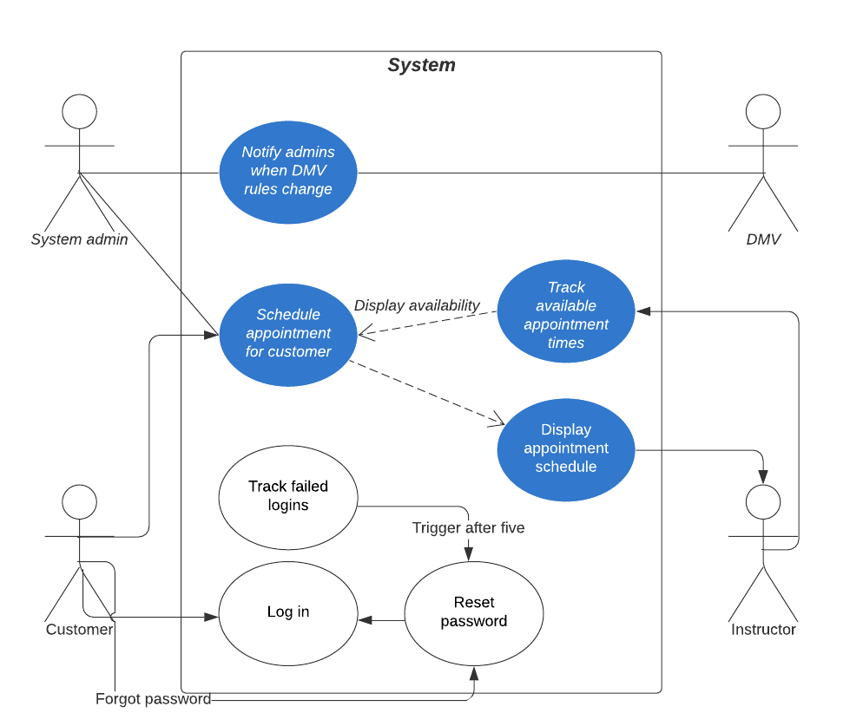
Use Case Diagram
Notes:
[Explain your diagram. Who are the different actors in the system? What are the different use cases? How did you account for DriverPass’s needs in your design? In your explanation, keep your audience in mind. Avoid the use of terms like “actors” and “use cases” in your explanation.]

Slide 5
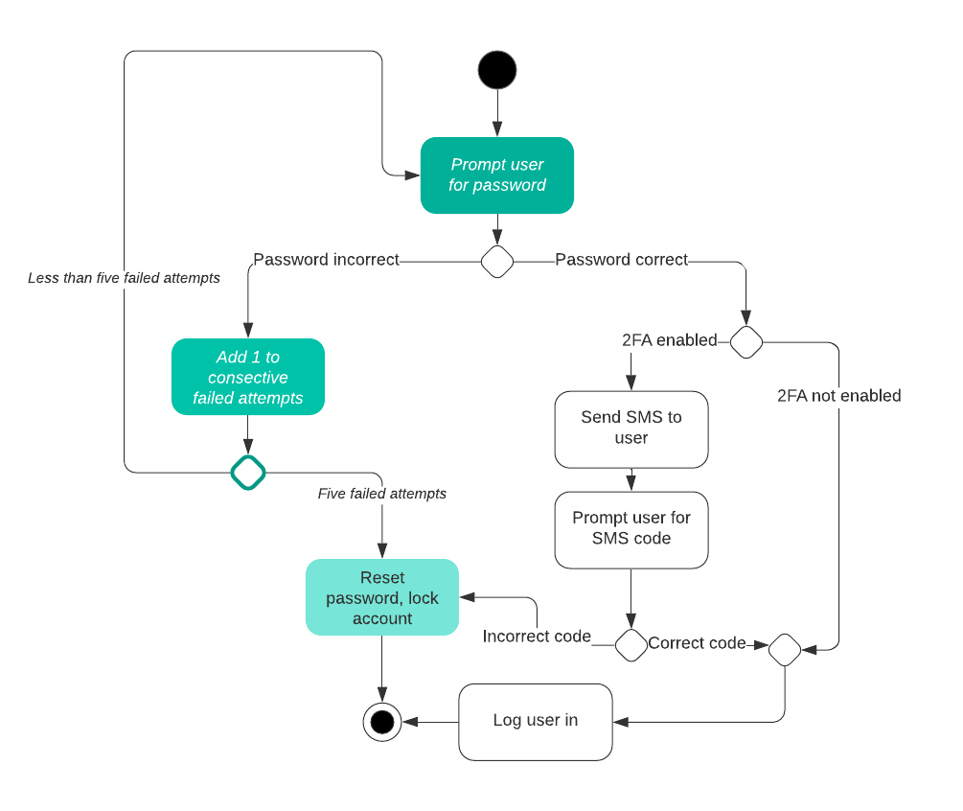
Activity Diagram (User login)
Notes:
[Explain your diagram. Which use case are you breaking down? What are the steps for this use case? How did you account for DriverPass’s needs in your design? In your explanation, keep your audience in mind. Avoid the use of technical terms such as “nodes,” “control flows,” and so on.]

Slide 6
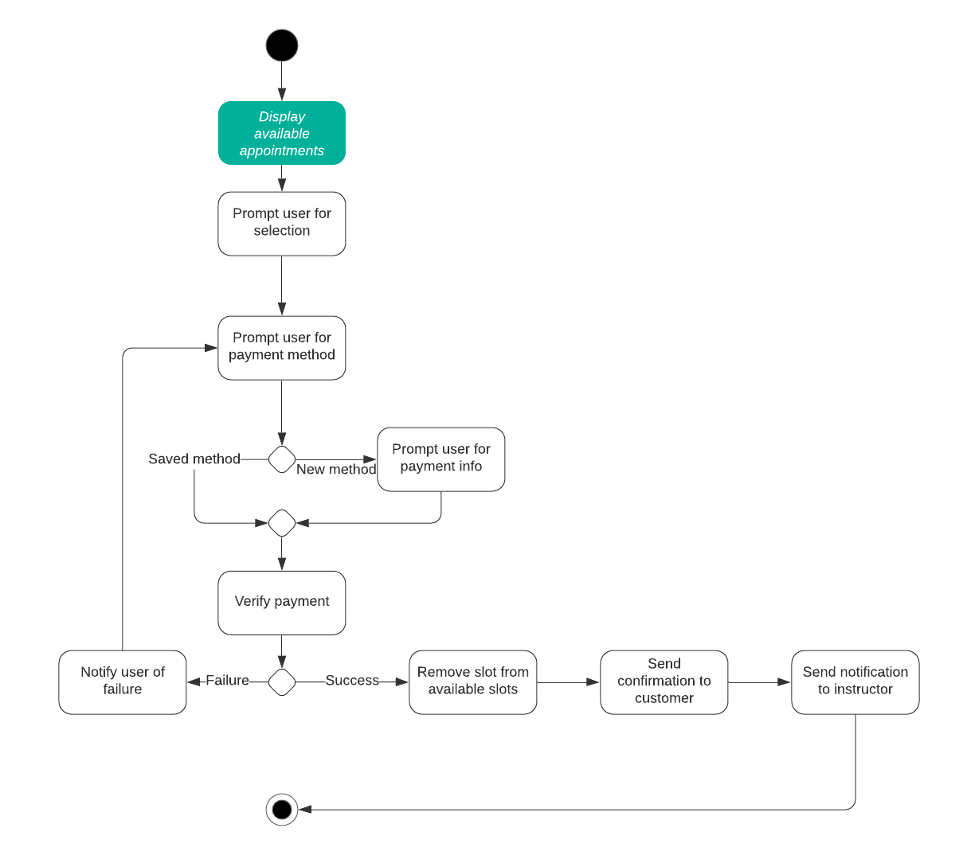
Activity Diagram (Schedule an appointment)

Slide 7
Security
The log in will be secure.
Both the user and the admin will be notified of this brute force breach.
Logging off. In order to avoid any long-term harm, the servers will shut down if the attack is severe enough.
The user can reset their username or password if they forget it.
Notes:
[How did you consider security in your design? In your explanation, keep your audience in mind by avoiding the use of technical terms.]

Slide 8
System Limitations
The time constraints don't take into consideration any programming faults if the team
approaches a dangerous bug
Barring a significant security vulnerability or defect, the budget should be solid. Then it will arrive.
Directly outside of profit margins.
There are no technological restrictions, although a computer's web browser often has more features.
More processing power than a smartphone. To guarantee the IOS app and the Android
Well-optimized application.
Notes:
[What are the limitations of your design? In your explanation, keep your audience in mind by avoiding the use of technical terms.]

